Slide 1

SYSTEM PERFORMANCE EVALUATion
Elevator evaluation
HCM University of Technology

Slide 2
TABLE OF CONTENT
INTRODUCTION
EVALUATION PROCESS

Slide 3
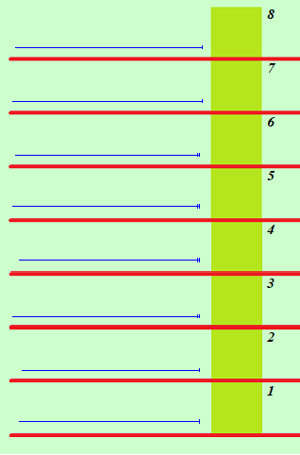
INTRODUCTION
Elevator system with one cabin and eight floors
Workload based on different points of time in a day

Slide 4
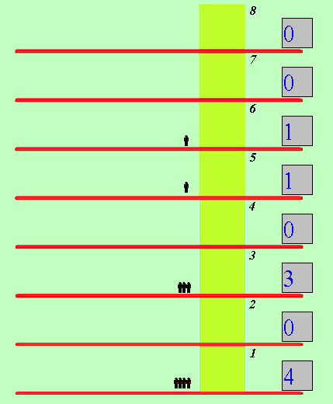

EVALUATION PROCESS
State goals and define the system
Evaluate the effects of transition time and cabin capacity of the elevator to the users
System : Waiting queue line in each floor + cabin + students in the cabin

Slide 5
EVALUATION PROCESS
List service and Outcomes
Service :
  Moving people between the floors
Outcome :
  Students are still in the elevator
  Students came out of elevator
  Students are waiting the elevator
  There is no student

Slide 6
EVALUATION PROCESS
Select metrics
Mean of students’ waiting time
Maximum of students’ waiting time
Mean of waiting time for each floor
Maximum of waiting time for each floor
Average number of students in each floor
Utilization of elevator
Number of students served
Maximum waiting time in the elevator

Slide 7
EVALUATION PROCESS
List parameters
System parameters
Workload parameters
CPU : Intel Core i3
RAM : 4096 MB
OS : Windows 10 Community
Software : Arena Student Version
Number of floors : 8
Capacity of elevator
Transition time
Arrived rate
Bursting time
Probability of arriving floor

Slide 8
EVALUATION PROCESS
List factors to study
Capacity of elevator
Transition time

Slide 9
EVALUATION PROCESS
Select evaluation technique
The simulation method

Slide 10
EVALUATION PROCESS
Select workload
Type : Bursting
Arrival time is exponential distributed

Slide 11
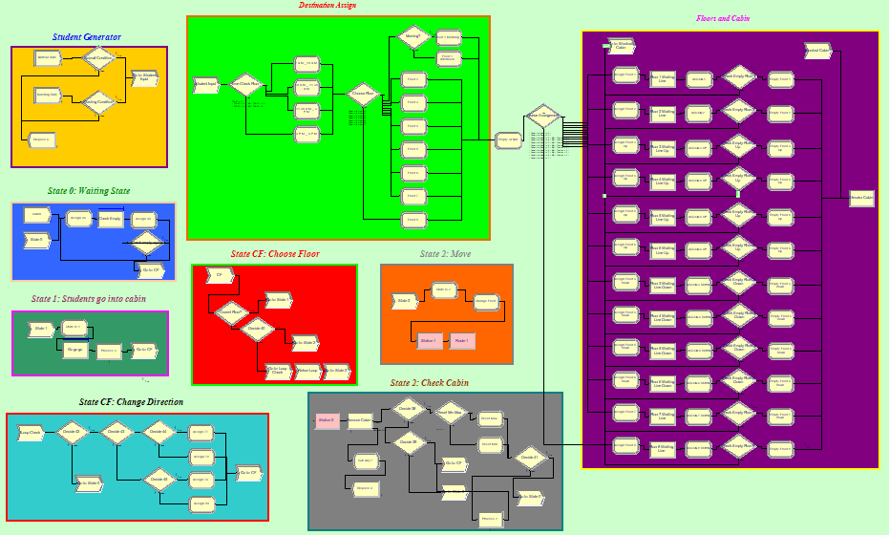
EVALUATION PROCESS
Design experiment
a) Model overview

Slide 12
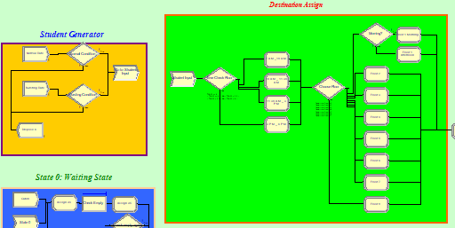
EVALUATION PROCESS
Design experiment
Entity generators
Function : Generate a random number of students and assign each student a floor

Slide 13
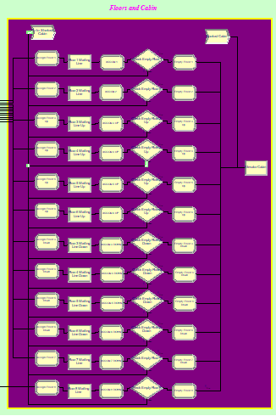
EVALUATION PROCESS
Design experiment
The queues
Function : Taking the students into the queue for easier management

Slide 14
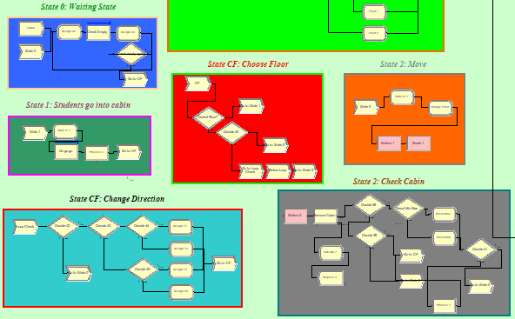
EVALUATION PROCESS
Design experiment
Controller – state machine blocks
Function : Moving students with C-LOOK algorithm, implemented by using state machine

Slide 15
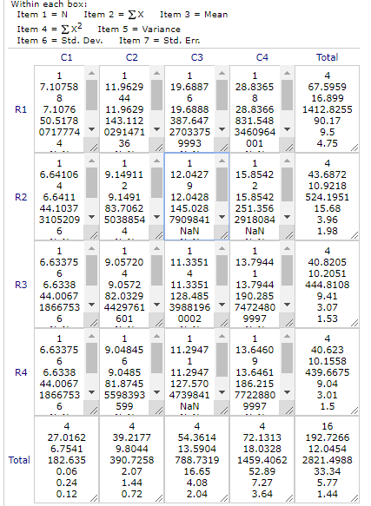
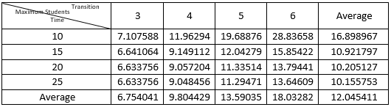
EVALUATION PROCESS
Analyze and interpret data
Average waiting time

Slide 16
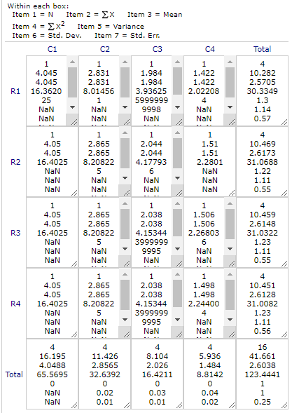
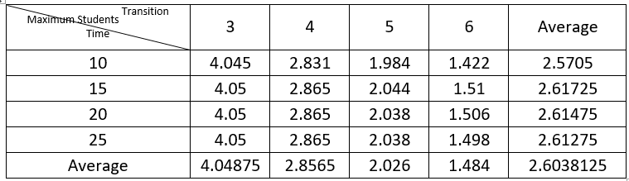
EVALUATION PROCESS
Analyze and interpret data
b) Elevator’s idle time

Slide 17
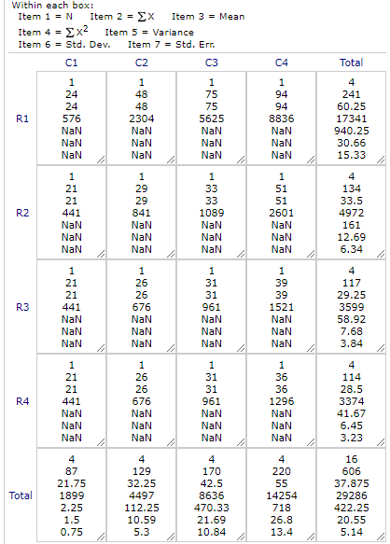
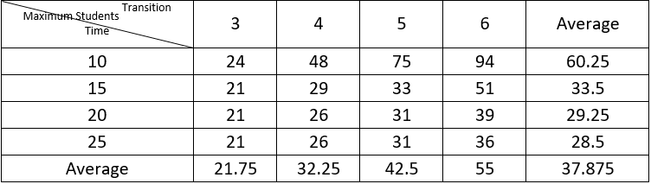
EVALUATION PROCESS
Analyze and interpret data
c) Maximum number of students in the system

Slide 18
EVALUATION PROCESS
Present Results

Slide 19
THANKS
FOR
WATCHING
Take my energy and have a good day つ ◕_◕ ༽つ

